Slide 1
Black box optimization using Gaussian Processes and Bayesian Optimization
Crash course

Slide 2
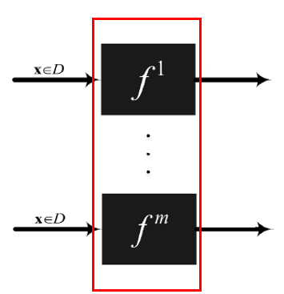


What is black-box optimization?
c
Generic system: black box
x = (x₁,…x_{d}) = controls (decision variables, actions)
y = (y¹ ,.., y^{m}) = performance measures, objectives, goals:
Analytically intractable, but you have some “expensive model” (physical experiment, simulation model,…) to evaluate it
Can be just one objective (single obj), or multiple (conflicting) objectives simultaneously (multi-obj)
$$y^{1}$$
$$y^{m}$$
GOAL = find the control settings that optimize the objective(s), subject to constraints (if any)
Examples:
Production process: process parameters → impact on product quality, product cost,…
Cancer treatment: radiotherapy settings → impact on tumor, impact on healthy organs,…
Machine learning algorithms: hyperparameters → model accuracy, training time,…

Slide 3
What makes these problems challenging?
We focus specifically on black-box problems that are Expensive to run:
“simulator” takes a lot of time/money to evaluate the performance measures for a given x
Optimization algorithms need to be data-efficient
How?
Fit a “metamodel” based on a limited number of input/output observations (Gaussian process model)
Smartly select new inputs to simulate, one by one, each time updating the metamodel!
This is called “Bayesian optimization”!!

Slide 4
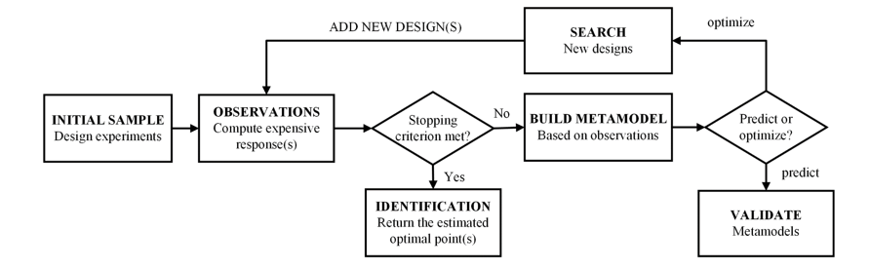
Bayesian optimization
Sequential optimization method: selects next point to observe (sample/simulate) using an infill criterion/acquisition function

Slide 5
What is the goal of the thesis?
Compare different algorithms for CONSTRAINED Bayesian optimization:
ALL algorithms use GP
BUT they all have a different acquisition criterion
How do they compare? How “data efficient” are they in reaching the optimum?
Which algorithms? Pourmohamad and Lee, Tao et al, “traditional approach”
Which test problems? 3 predefined problems

Slide 6
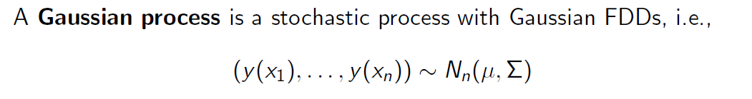
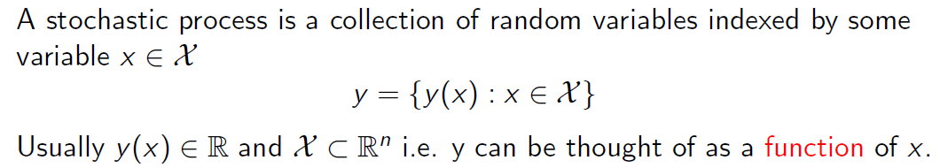
What is a Gaussian process?
For each finite set of x values, the corresponding y values are multivariate normally distributed, with mean vector μ, and covariance matrix Σ

Slide 7
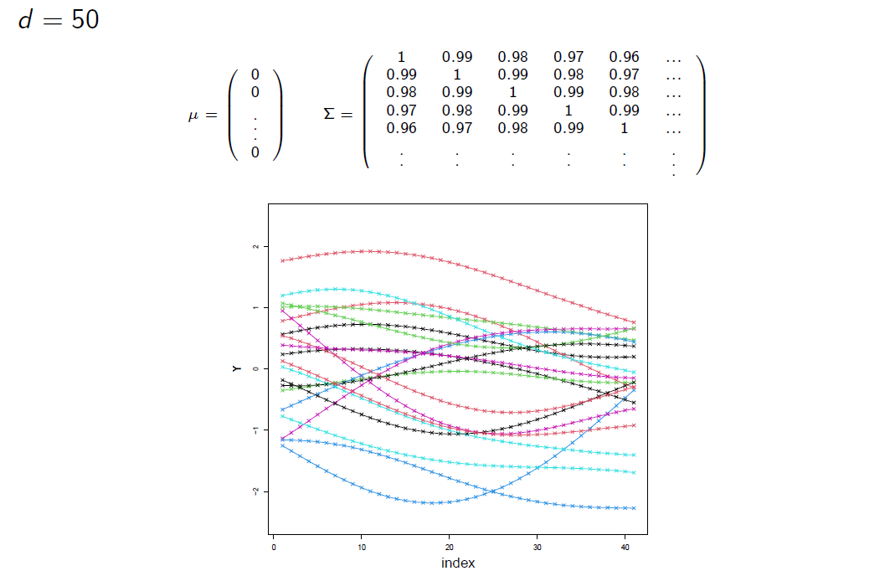
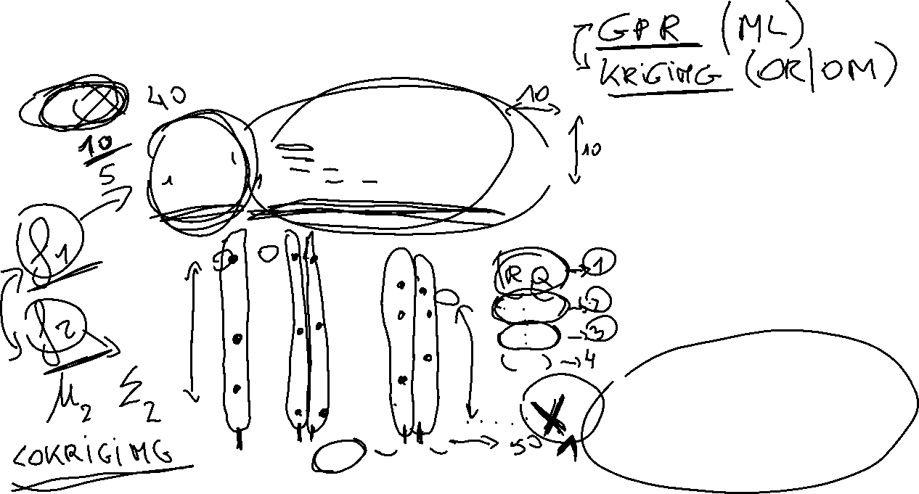
What is a Gaussian process?
Each line (=“function”) is a sample from a multivariate (41-variate!!) normal distribution
Not every sample has the same probability of occurring!
We can see the Gaussian process as a distribution over functions!!
For given μ and Σ, it models a whole space of possible outcome functions!

Slide 8
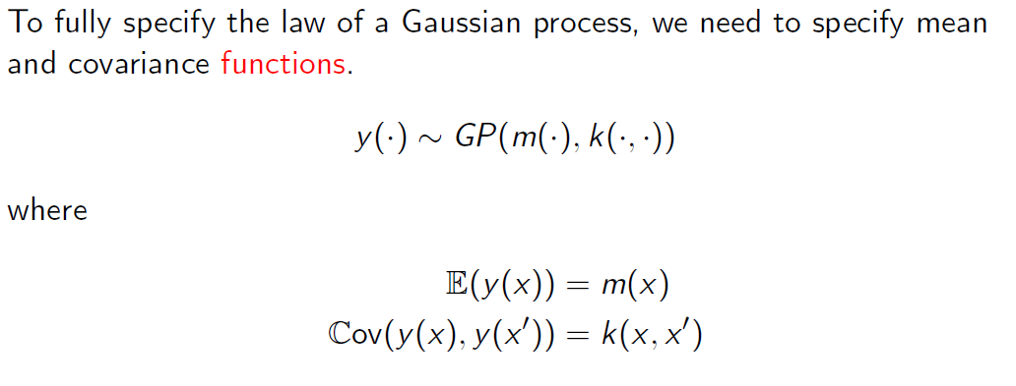
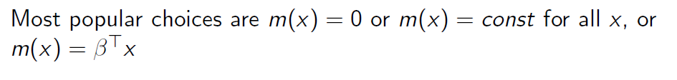
Specifying a Gaussian Process
Covariance function = kernel: models the smoothness of the functions in your hypothesis space!!
Note: Covariance between two outputs is determined by the respective locations of the two inputs!!

Slide 9
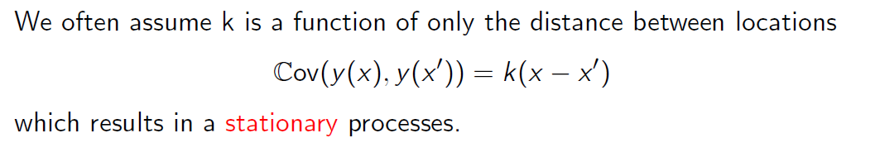
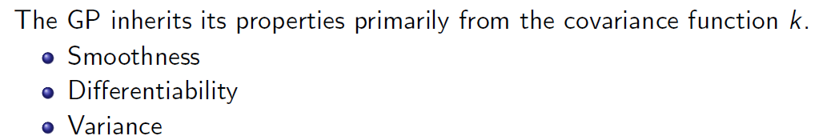
Specifying a Gaussian Process

Slide 10
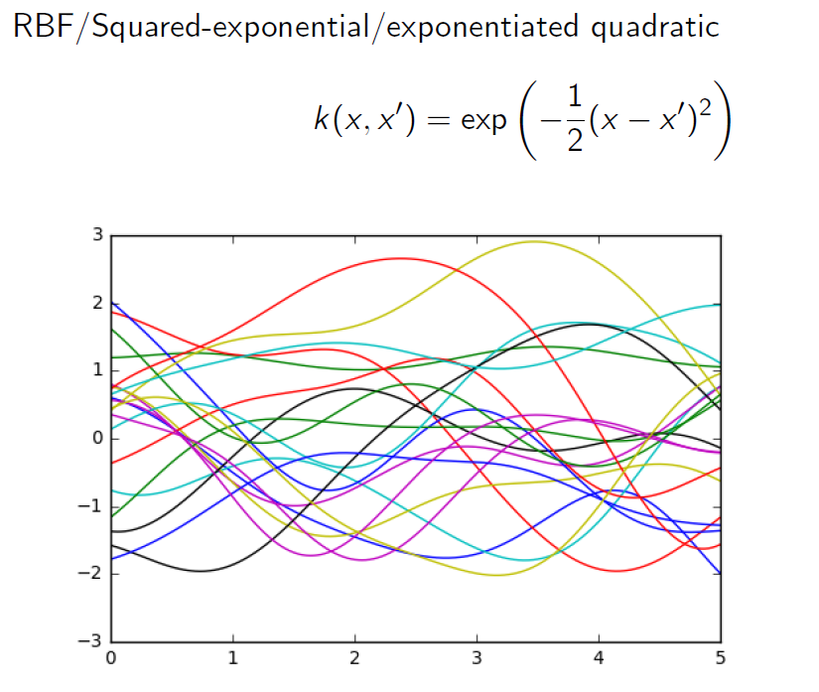
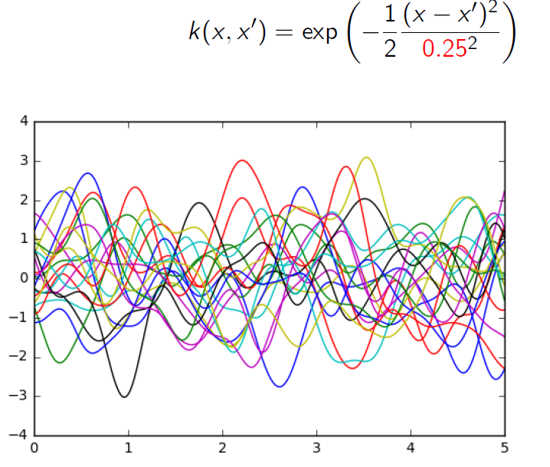
Specifying a Gaussian Process
Length scale parameter: determines how fast correlation in the output dies out as the distance between two input locations increases (large value for length scale → dies out more slowly; low value → dies out faster)

Slide 11
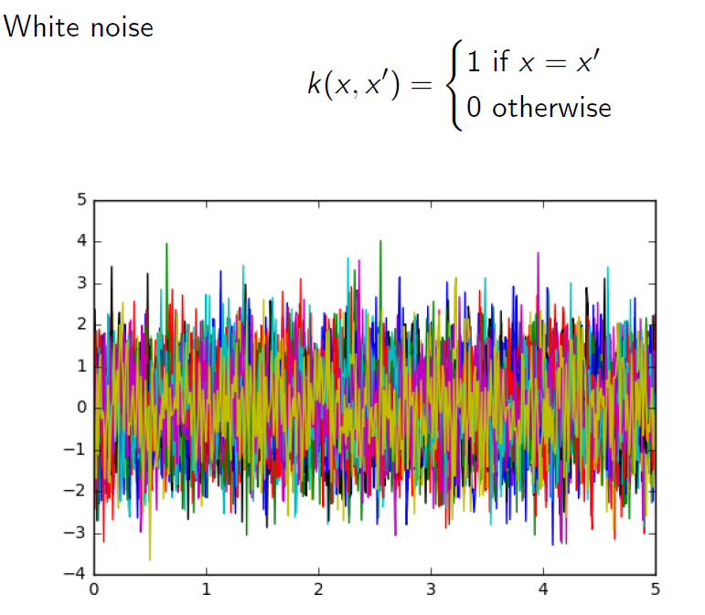
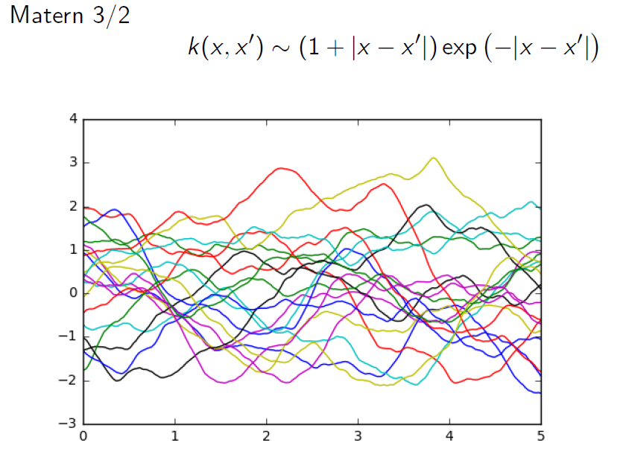
Specifying a Gaussian Process
Many choices! Kernel TYPE determines the space of functions you assume your data to come from.

Slide 12
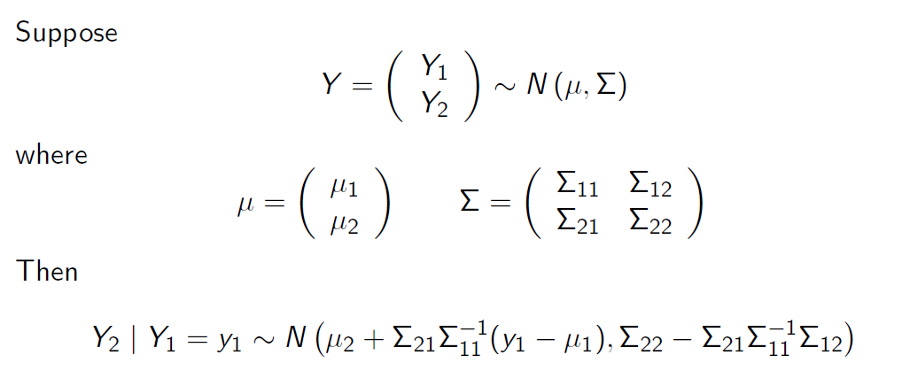
Prediction of outputs, given a set of observations
Often: mean is assumed to be constant (ie, the same across locations): μ₁= μ₂
mean
Covariance matrix
Conditional distribution of set of outputs Y₂, given an already available set of outputs Y₁ observed at given input locations, is multivariate normally distributed with a “known” mean and covariance matrix!

Slide 13
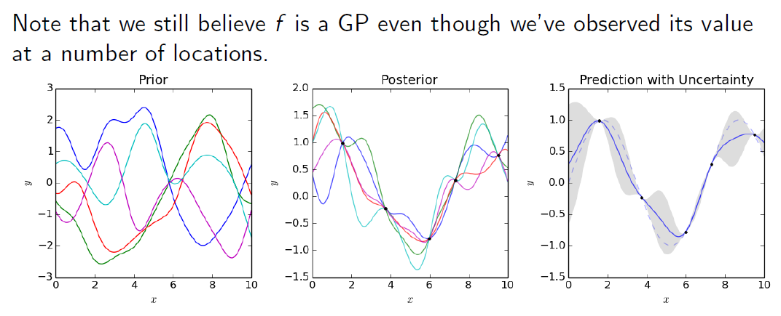

Prediction of outputs, given a set of observations
DACE code in Matlab yields predictor and MSE values for any arbitrary point in X space!
Posterior: the set of functions is “restricted” to those that go through the observations!

Slide 14
Bayesian optimization
Infill criterion automatically balances exploitation (sampling points with “good” expected performance) and exploration (sampling points with high uncertainty! These lie in regions where you have very few or even no samples yet)
Example: Expected improvement (Efficient Global Optimization method, Jones et al., 1998)

Slide 15
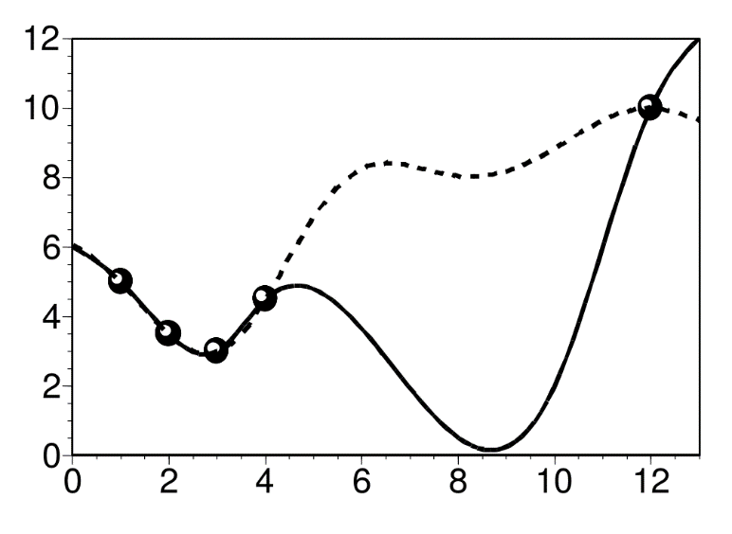
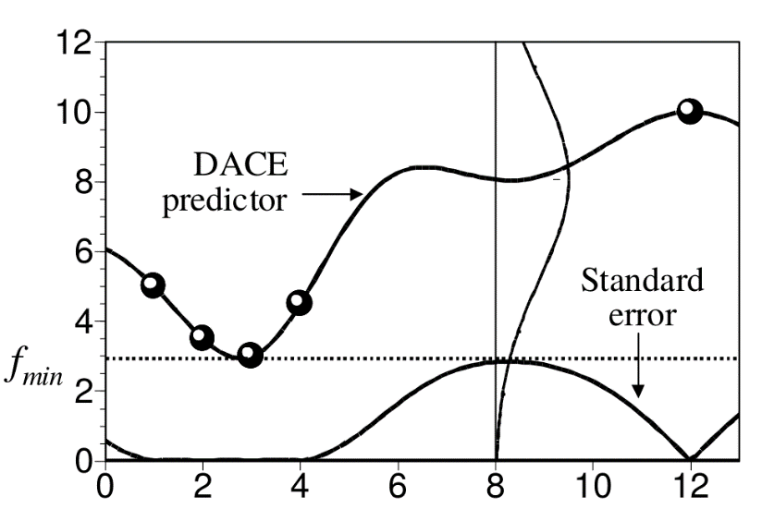


Bayesian optimization
Efficient Global Optimization Expected Improvement
Jones, D. R., Schonlau, M., & Welch, W. J. (1998). Efficient global optimization of expensive black-box functions. Journal of Global Optimization, 13, 455–492.
Notes:
BayesOpt originated with the work of Kushner (Kushner, 1964), Zilinskas (Zilinskas, 1975; Moˇckus et al., 1978), and Moˇckus (Moˇckus, 1975; Moˇckus, 1989), but received substantially more attention after that work was popularized by Jones et al. (1998) and their work on the Eﬃcient Global Optimization (EGO) algorithm

Slide 16
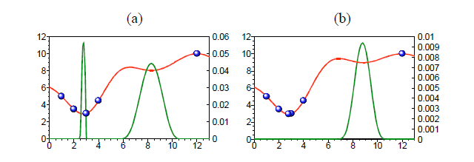
Bayesian optimization
Efficient Global Optimization Expected Improvement
Jones, D. R., Schonlau, M., & Welch, W. J. (1998). Efficient global optimization of expensive black-box functions. Journal of Global Optimization, 13, 455–492.
Max EI tells you where to sample next!
After 5 samples
After 6 samples
Notes:
BayesOpt originated with the work of Kushner (Kushner, 1964), Zilinskas (Zilinskas, 1975; Moˇckus et al., 1978), and Moˇckus (Moˇckus, 1975; Moˇckus, 1989), but received substantially more attention after that work was popularized by Jones et al. (1998) and their work on the Eﬃcient Global Optimization (EGO) algorithm

Slide 17
Next steps for the thesis
You:
Read papers: Jones et al, Pourmohamad and Lee, Tao et al (see email)
Download MATLAB from UHasselt software site
Experiment with DACE toolbox:
Install toolbox from zip file (see email) and save DACE pdf file (see email)
Read reference manual (section 5 of DACE pdf)
Try work-through example (section 6 of DACE pdf)
Me:
Provide “framework code” for experiments
Next meeting?

Slide 18
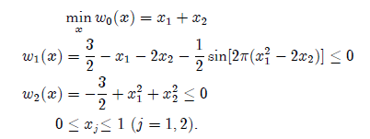
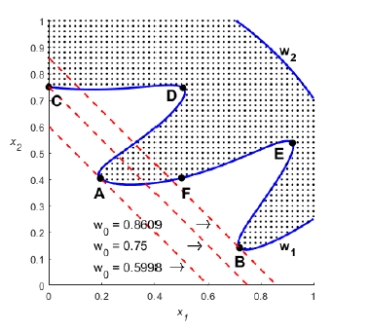

Toy example (Gramacy et al.2016)
Global optimum

Slide 19
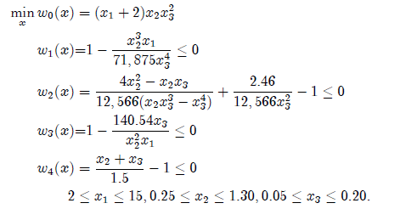
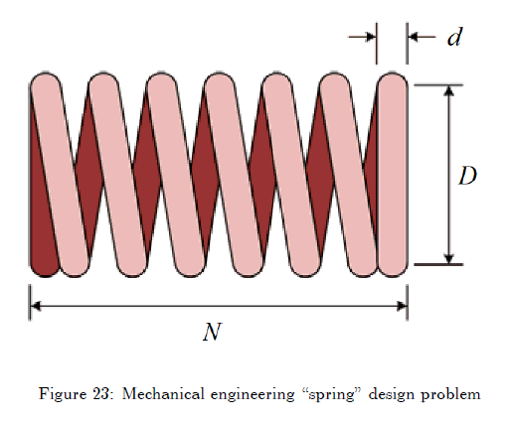
Tension-compression spring example
minimize the weight of the spring (w0), subject to constraints on the minimum deflection of the spring caused by the axial loading (w1), the maximum shear stress (w2), the surge frequency (w3), and the outside diameter of the spring (w4)
N = x₁
D=x₂
d=x₃
Notes:
Tension-compression

Slide 20
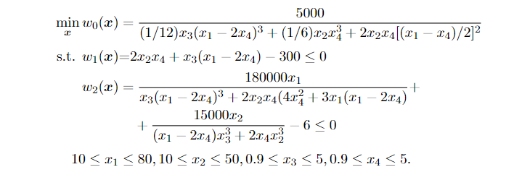
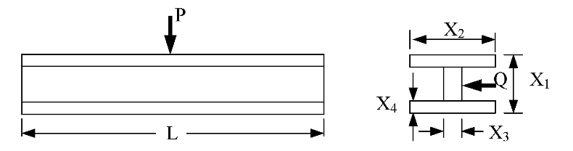
I-beam design problem
minimize the vertical deflection of an I-beam, subject to cross-section area and stress constraints under given loads (Tao et al. (2020))

